Slide 1
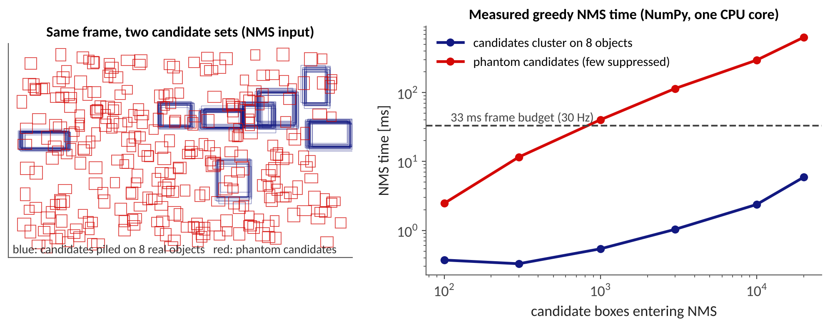
L4.3 Latency / Availability Attacks for AD
Zonghua Gu | Fall 2026
Based on arXiv:2609.36732 (survey) and the LiU talk; figures marked 'original' are our own simulations or measurements
Notes:
Companion to L3.3. L3.3 asked: can an attacker make the vehicle see something wrong? L3.4 asks: can an attacker make the vehicle see the right thing too late? Based on the survey by Gu, Gao, Saremi and Chakraborty (arXiv:2609.36732) and the LiU talk on security-aware automotive CPS. About 75 minutes: why 12 min, perception 20, VLM/LLM 10, defenses 13, model-to-system 12, open problems 8. Title figure: our own measurement of greedy NMS in NumPy on one CPU core, benign clustered candidates vs. phantom candidates.

Slide 2
Outline
Why availability matters for AD
Latency attacks on perception
Latency attacks on VLMs and LLMs
Defenses: work budgets
From model-level cost to system failure
Open problems and discussion
Notes:
Roadmap. The thread through the lecture: an attack that only inflates the amount of work can still be a safety attack, but whether it is depends on the system, not on the model. Part 5 makes that precise.

Slide 3
Integrity vs. Availability
 | Integrity attack (L3.2, L3.3) | Availability / latency attack (today)
Attacker goal | Wrong output: misclassification, hidden object, phantom | Late output, or none: more work, energy, or delay
Typical metric | Attack success rate, mAP drop | Amplification factor, deadline-miss rate, tardiness
Output when attacked | Different from clean | Often identical to clean, just delayed
Why it is hard to notice | Accuracy monitors fire | Task-accuracy monitors stay silent
Victim resource | The decision | Time, energy, GPU/CPU share, queue capacity
Gu et al., Latency Attacks survey, arXiv:2609.36732, Sec. 1 and 2.
Notes:
Anchor the lecture in the CIA triad. Everything in L3.2 and L3.3 was integrity. Here the attacker may leave the prediction untouched (some attacks even preserve it by design, e.g., Phantom Sponges keeps the original detections) and instead attacks the clock.

Slide 4
AD Perception Lives Under a Deadline
50-100 ms
200 ms
+6 m
typical per-frame
perception budget
extra latency
travelled before braking
at 30 m/s (108 km/h)
Chatbot
A slow answer is an annoyance; the user waits or retries
No physical consequence
Autonomous vehicle
A missed deadline means a stale or missing decision
Attack surface is physical: roadside patch, projected light, billboard
LiU talk (Gu), Timing and Availability Attacks; arithmetic: 0.2 s x 30 m/s = 6 m.
Notes:
Numbers from the LiU talk: perception must finish within roughly 50-100 ms per frame; a missed deadline produces a stale or absent decision. The 6 m figure is simple arithmetic: 0.2 s x 30 m/s. Physical attack surface: roadside patches, projected light, billboards. Contrast with a chatbot where a slow answer is annoying but not dangerous.

Slide 5
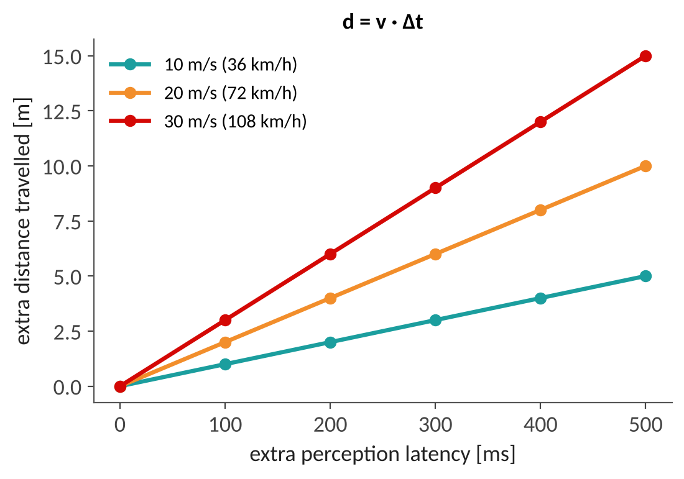
Delay Becomes Distance
Every extra millisecond of perception latency is distance travelled blind: d = v · Δt
At 30 m/s, 100 ms costs 3 m, 300 ms costs 9 m
The planner may also act on a stale world model: objects have moved since the frame was captured
Questions for this lecture: how large a delay can an attacker cause, and is that delay big enough to matter?
Original figure (d = v · Δt).
Notes:
Original figure, simple kinematics. Ask: at which speed and delay does the extra distance exceed a typical safety margin? This motivates the deadline-based analysis in Part 5.

Slide 6
What Is a Latency Attack?
Goal: inflate inference-time work, energy, or response time rather than (only) cause a wrong answer
Also called energy-latency, sponge, slowdown, or resource-consumption DoS attacks
Outcome: deadline misses, throughput collapse, resource exhaustion, sometimes while preserving the nominal prediction
Unifying mechanism: intermediate-work amplification: a small input drives many more boxes, tracks, tokens, or steps through a stage whose cost grows super-linearly
Caution: 'worst case' is reserved for proven maxima; most papers find high-cost inputs, not true worst cases
Gu et al., Latency Attacks survey, arXiv:2609.36732, Sec. 1 and 2.5.
Notes:
Definitions from the survey. Stress the last bullet: do not call an empirically found slow input the worst case; in real-time systems the word has a precise meaning (WCET).

Slide 7
Intermediate-Work Amplification
Input of normal size
(patch, prompt, message)
Many intermediate objects
boxes, tracks, tokens
Stage with super-linear cost
NMS, association, decoding
Latency / energy up
deadline missed
• NMS: cost grows with the number of candidate boxes admitted
• Tracker association: cost grows with tracks × detections, and false tracks persist across frames
• Autoregressive decoder: cost grows with the number of generated tokens (reasoning tokens included)
• Different from request flooding or oversized inputs: the input looks benign in size
Gu et al., Latency Attacks survey, arXiv:2609.36732, Sec. 2.5.3.
Notes:
Walk the flow. The input has the same externally visible size as a benign input (same image resolution, same prompt length). What changes is the number of intermediate objects: candidate boxes, tracks, tokens. A stage whose cost is quadratic in that number does the rest. This is what separates a latency attack from simply sending a huge input or flooding with requests.

Slide 8
Metrics: Report More Than a Ratio
Quantity | Definition | Why it matters for AD
Amplification factor | AF = M(x_adv) / median M(x_0) over matched benign inputs | Same model, batch size, hardware, and concurrency; avoids cherry-picked baselines
Deadline-miss increase | p_attack − p_clean (absolute, preferred) | Real-time systems have near-zero clean miss rate, so the ratio is undefined
Slack and tardiness | S = d − f ; τ = max(0, f − d) | How late, not only whether late
Consecutive misses, recovery time | Longest run of missed frames; time to recover after the attack stops | Stateful pipelines (trackers) stay degraded after the input is gone
Gu et al., Latency Attacks survey, arXiv:2609.36732, Sec. 2.5.1-2.5.2.
Notes:
d is the absolute deadline and f the completion time of a job. With a common relative deadline D, S = D - T. The survey recommends reporting the absolute miss increase because clean miss rates are near zero. Also note that work-proxy increases (candidates, tokens) need not translate to proportional wall-clock increases.

Slide 9
Delivery Channels
Delivery channel | What the attacker controls | Perception / AD examples
Digital input | Image, point cloud tensor | Phantom Sponges, Overload, SlowTrack, SlowLiDAR, TrackFlood
Physical sensor delivery | Printed patch, lens sticker, projector | SlowPerception, DetStorm (Groundswell proposes it; evaluated digitally)
V2V message | Shared sensor data or features | CP-FREEZER (cooperative perception)
Prompt, API, retrieved content | Text or image sent to a served model | Verbose Images, ReasoningBomb, OverThink
Training data or backdoor | Training samples | Sponge backdoor on detectors; reflection backdoor on a driving VLM
Weights or hardware | Parameter bits | Rowhammer bit flips on NMS behavior (20.4×, 31 flips)
Gu et al., Latency Attacks survey, arXiv:2609.36732, Table 2.
Notes:
How the attacker reaches the system. Note that physical realizability is a property of the sensing channel; API prompts and poisoning can be deployable without any physical artifact. Persistent channels (poisoning, bit flips) leave no trace in the test-time input.

Slide 10
Bottleneck vs. Delivery Channel
Bottleneck: what makes it expensive
Delivery channel: how it is triggered
NMS candidates
Tracker state
LiDAR preprocessing, cooperative fusion
Activation sparsity, early exit
Output / reasoning length
Digital input, physical patch or projector
V2V message, prompt or API
Retrieved content
Training poison or backdoor
Weight or hardware tampering
• The two axes are orthogonal: any bottleneck can be reached through several channels
• The channel decides persistence, detectability, and cost; the bottleneck decides which control bounds the work
• This lecture is organized by bottleneck
Gu et al., Latency Attacks survey, arXiv:2609.36732, Sec. 3.3.
Notes:
The survey keeps two questions apart. What makes the computation expensive is the bottleneck; how the attacker triggers it is the delivery channel. Example: an EOS-delaying prompt, a no-EOS backdoor and an EOS-suppressing bit flip all lengthen generation: same bottleneck, three channels, and the same class of controls (a hard token cap) bounds all three.

Slide 11
How the Field Got Here
2021
Sponge Examples
energy and latency
of a network
2022
NICGSlowdown
caption decoder
length
2024
Verbose Images
VLM output
length
2024
SlowTrack
camera perception
in closed loop
• Early work: a single model, measured in FLOPs or energy
• Then: pipeline stages around the model (NMS, tracker) and their real-time consequences
• Now: physical delivery, cooperative perception, and VLM/LLM-based driving (this lecture)
Sponge Examples (EuroS&P 2021); NICGSlowdown (2022); Verbose Images (ICLR 2024); SlowTrack (AAAI 2024). LiU talk, slide 29.
Notes:
Short history from the LiU talk. Sponge Examples (2021) introduced energy-latency attacks on neural networks; NICGSlowdown (2022) brought the idea to captioning decoders; Verbose Images (2024) to VLMs; SlowTrack (2024) to the stack of an AD perception pipeline with closed-loop crash evidence. The point: the target moved from a single network to the pipeline and then to the vehicle.

Slide 12
Outline
Why availability matters for AD
Latency attacks on perception
Latency attacks on VLMs and LLMs
Defenses: work budgets
From model-level cost to system failure
Open problems and discussion
Notes:
Part 2 (about 20 minutes): NMS, tracking, LiDAR and cooperative perception. Recall L1.3 for the LiDAR pipeline and L3.3 for tracking-by-detection.

Slide 13
NMS: The Quadratic Bottleneck
Detector head:
N candidate boxes
Confidence filter
and sort
Greedy NMS:
pick best, suppress overlaps
Kept boxes
(to tracker)
• Benign scene: boxes cluster on a few objects, so each pick removes many candidates
• Attack: the perturbation adds many small, spread-out phantom boxes that overlap nothing, so almost none are suppressed
• Worst case grows like n² comparisons in the number of admitted candidates
• Phantom Sponges keeps the original detections: accuracy does not betray the attack
• What matters for cost is how many candidates reach NMS, not how many leave it
Phantom Sponges (WACV 2023); Gu et al., Latency Attacks survey, arXiv:2609.36732, Sec. 4.1.
Notes:
Recall NMS: sort candidates by score, keep the best, suppress all candidates that overlap it above an IoU threshold, repeat. Real objects produce clusters of near-identical boxes, so each pick suppresses many; the loop is short. Phantom candidates are small boxes spread over the frame that overlap nothing, so almost nothing is suppressed and the work approaches n^2 comparisons. This is the weakness Phantom Sponges and Overload exploit.

Slide 14
Measured: Phantom Candidates Blow the Budget
Our NumPy greedy-NMS micro-benchmark, one CPU core: at 1,000 candidates the phantom set costs 40 ms vs. 0.5 ms when boxes cluster on 8 objects, already above a 33 ms frame budget
At 20,000 candidates: 633 ms (phantom) vs. 5.9 ms (clustered): a ~100× gap at the same n
Caveat: real detectors cap the candidates they pass on, and GPU kernels differ (see the EVADE re-evaluation)
Original figure: measured NumPy NMS (synthetic boxes). Illustrative, not a production detector.
Notes:
Original measurement, not from a paper: a plain NumPy implementation of greedy NMS, run on one CPU core, with synthetic candidate boxes. Benign set: boxes piled on 8 objects. Phantom set: small random boxes. It illustrates the mechanism and the n-dependence, not the speed of any production detector (GPU kernels, batching and pre-NMS caps change absolute numbers). The 33 ms line is a 30 Hz frame budget.

Slide 15
Attacks on NMS
Attack | Idea | Reported result (native metric)
Phantom Sponges (WACV 2023) | Universal perturbation adds many phantom boxes, original detections preserved | NMS overloaded; detections preserved
Overload (CVPR 2024) | Latency maximization with spatial attention, NMS-agnostic | Inference time up to 10× on edge devices
Beyond PhantomSponges (2024) | Box-area loss lowers IoU, exacerbates NMS load | Up to +550 % NMS time (YOLOv5-small)
Groundswell (VehicleSec 2026) | Regional Perturbation Balance places phantoms with minimal interference | Candidates 101 → ~19k; 15.2 → 41.4 ms
Steal Now, Attack Later (2024) | Black-box ghost objects from reusable components | Works on common detectors and a commercial API, < $1 per example
Gu et al., Latency Attacks survey, arXiv:2609.36732, Sec. 4.1 and Table 3. Numbers as reported; setups differ.
Notes:
Each number uses the paper's own metric and baseline; do not compare across rows. Groundswell is the most detailed on candidate counts and is shown on the next slide. 'NMS-agnostic' in Overload means the optimization is not tied to one NMS implementation; it still works by proliferating candidates.

Slide 16
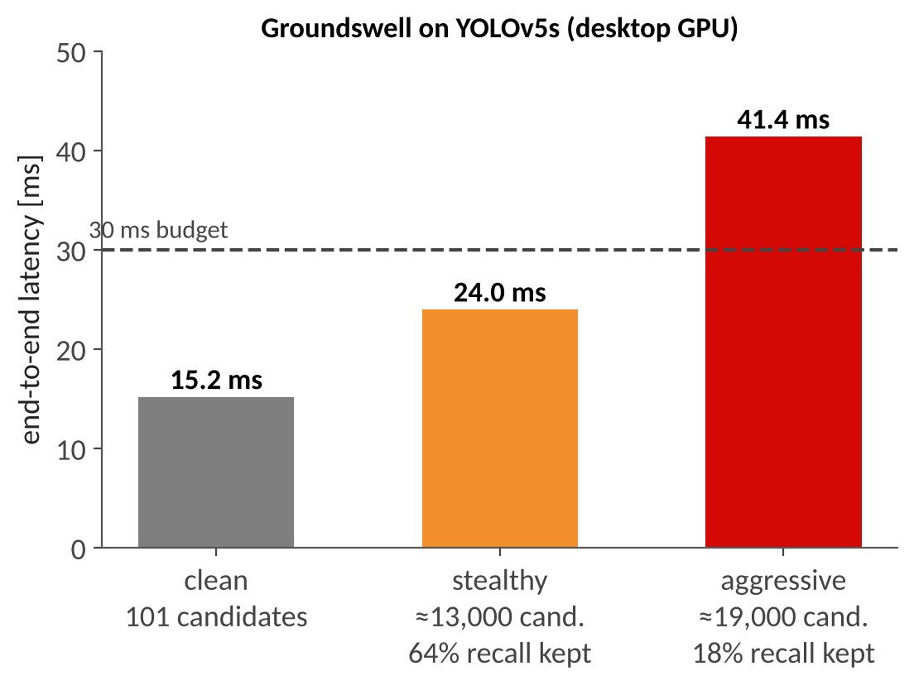
Groundswell: Stealth vs. Strength
Same attack, two operating points on YOLOv5s (desktop GPU)
Stealthy: ~13,000 candidates, 64 % of original detections kept, 24.0 ms: still under a 30 ms budget
Aggressive: ~19,000 candidates, only 18 % recall kept, 41.4 ms: over budget, but the detector is largely blinded
A 188× rise in candidates gives only 2.7× end-to-end latency: NMS is a small part of the pipeline (Part 5)
Groundswell (Xia, Gao, Shi, VehicleSec 2026), as reported in Gu et al., Latency Attacks survey, arXiv:2609.36732, Sec. 4.1. Chart redrawn from the reported values.
Notes:
The source text says 'more than 300-fold' and '250%'; its tabulated values correspond to about 188x and 2.7x, which the survey reports and we follow. Note the trade-off: the attack that breaks the deadline also destroys recall, which is itself an integrity failure that monitors would see.

Slide 17
Physical Delivery: What Is Actually Shown
Attack | Physical channel | Evidence level | Reported
DetStorm (IEEE S&P 2025) | Projected / placed objects, multiple NMS variants | Target hardware | +506 % detected objects; delays up to 8.1 s
SlowPerception (2024) | Projector universal perturbation loading NMS and the tracker | Closed-loop simulation | Avg. 2.5 s latency; 97 % collision rate
Groundswell (2026) | Lens sticker or projection (proposed) | Digital, GPU-timed | Patches not optimized for physical deployment
Physical delivery is shown in pieces (projector + hardware timing, or projector + simulator). The survey notes that no entry denotes a full on-road deployment.
Gu et al., Latency Attacks survey, arXiv:2609.36732, Table 3 and Sec. 4.1-4.2.
Notes:
Teaching point on evidence levels. 'Physical' in the delivery column does not mean the whole chain was demonstrated on a road. SlowPerception's 97 percent collision rate is in a simulator with the authors' industry-grade system configuration. DetStorm reports hardware timing with physical objects. Be explicit about this when students ask 'is this real?'.

Slide 18
Reality Check: EVADE (NeurIPS 2025)
114
15 / 7
25k vs 8k
adversarial datasets
YOLO models / hardware platforms
pre-NMS proposal cap
YOLOv5 vs. YOLOv8
Findings
Attacks do not transfer across YOLO versions or sizes
Universal patches fail across datasets
Three defenses removed the effect on post-NMS counts
Analytically, GPU NMS cannot reach 100-500 ms budgets
Limits
One detector family, one metric (post-NMS box count)
DetStorm excluded (no public code)
Not shown: that such attacks are impossible
Amplification belongs to an attack, model, configuration triple
Monteuuis, Chen, Petit, Latency NMS Attacks: Is It Real Life or Is It Just Fantasy?, NeurIPS 2025; survey Sec. 4.1.
Notes:
Monteuuis, Chen and Petit re-evaluated the four NMS attacks with public code: 7 hardware platforms, 15 YOLO models, 3 export formats, INT8, 3 datasets, 3 defenses, 114 adversarial datasets. Findings: no transfer across YOLO versions or sizes, universal patches fail across datasets, three defenses removed the effect on post-NMS counts; but they do transfer across export formats. The hardware conclusion is analytical (microbenchmarks plus budgets), not a per-attack measurement. The cap numbers: YOLOv5 passes at most 25,000 proposals to NMS, YOLOv8 8,000. On CPU, YOLOv5 can reach a 2 s threshold, YOLOv8 stays under 500 ms. The study covers one detector family and one metric; the survey's conclusion is that amplification factors belong to an attack-model-configuration triple.

Slide 19
Tracking: A Second, Stateful Bottleneck
Tracker (SORT / ByteTrack style): predict each track, associate detections to tracks, update, spawn, retire (L3.3)
With M tracks and N detections, building the association matrix costs O(M·N); assignment can be higher (e.g., O(max(M,N)³) for Hungarian)
Key difference from NMS: the tracker has memory. Unmatched false tracks survive for R frames, so work accumulates across frames
Pool can grow toward R × |D|max even if per-frame detections are capped
Insight: detector-only attacks often fail because tracking absorbs noise (> 98 % detection success may be needed, Jia et al. 2020); latency attacks go through the tracker instead
Gu et al., Latency Attacks survey, arXiv:2609.36732, Sec. 4.2.
Notes:
Connects to L3.3 where we used the tracker as a filter. Here the same state becomes the weakness. Caveat from the survey: not all trackers use Hungarian matching; some use greedy or learned association; complexities depend on the implementation.

Slide 20
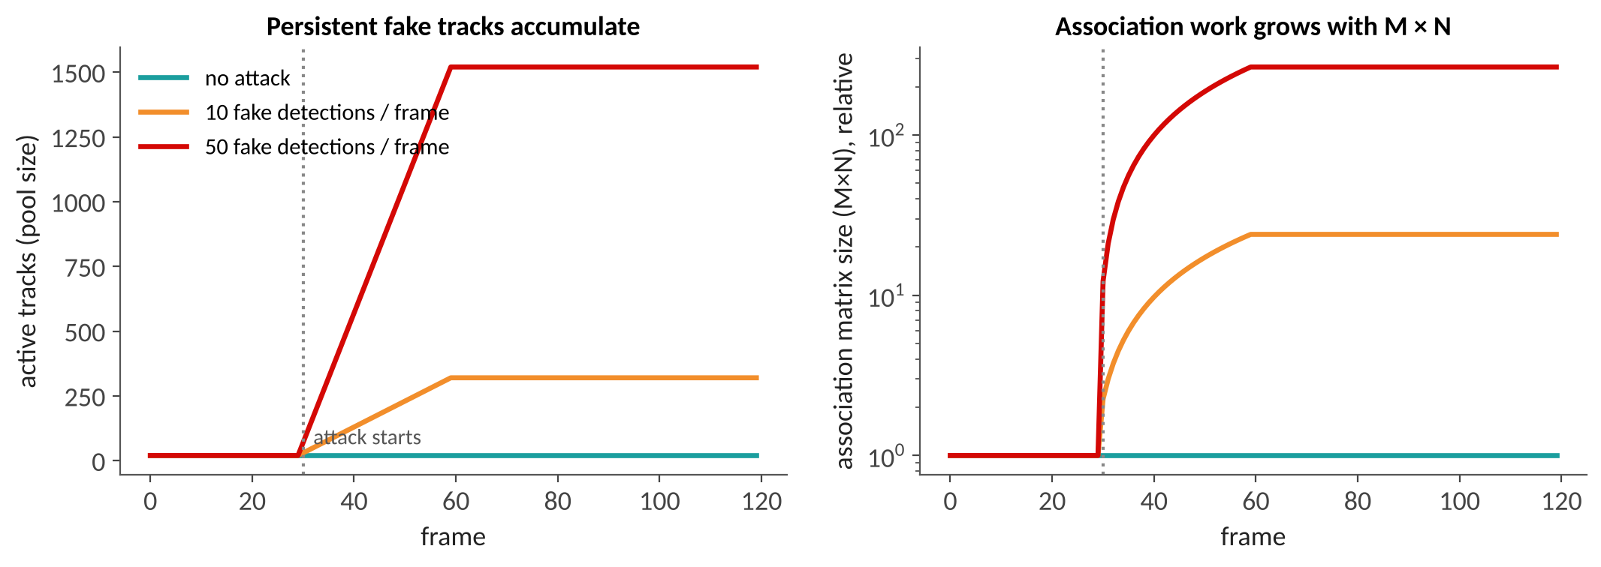
Why Per-Frame Caps Do Not Stop Accumulation
Toy model (original): attack starts at frame 30; fake tracks expire R = 30 frames after birth; 20 real objects
Pool saturates at about R × (fake detections per frame) and association work grows hundreds of times
A cap on detections per frame bounds one dimension of M × N, not the persistent pool
Original figure: toy simulation (illustrative).
Notes:
Original simulation, deliberately simple: each frame the attacker spawns n_fake tracks at fresh locations; tracks expire R frames later. 50 fake detections per frame gives a pool of about 1,500 tracks. The real numbers in the next slides come from SlowTrack on ByteTrack.

Slide 21
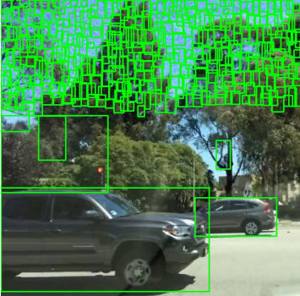
SlowTrack: Latency Through the Tracker
Camera-based perception, two-stage attack with three new loss designs
Exploits the confirmation delay for new tracks and the grace period before a lost track is deleted, so the pool grows without bound
Avg. 453.8× slowdown of the tracking stage and 28.4× for the whole camera pipeline (2.9× prior attacks)
On the authors' Apollo + LGSVL setup: crash rate ~95 % vs. ~30 % for baselines
Ma, Wang, Chen, Shen, SlowTrack, AAAI 2024. Figure via LiU talk.
Notes:
From the LiU notes: SlowTrack exploits the H-frame confirmation delay and the R-frame re-find grace period so that the tracker pool grows and the quadratic association cost explodes. The crash rate is from the authors' closed-loop simulation configuration (Baidu Apollo with the LGSVL simulator); it is not an on-road result. Figure from the paper via the LiU talk.

Slide 22
SlowTrack on a Jetson: Pool and Latency
20.5 → 1,678
3.3 → 140 ms
57.2 → 1.1
mean tracker pool
(tracks)
tracking-stage
latency
MOTA
(tracking quality)
• Jetson AGX Orin, YOLOX-S + ByteTrack: our group's measurement of SlowTrack's effect
• Not quality-preserving: the tracker is both slow and wrong
• Still effective under a 500-detection cap: per-frame caps do not bound the persistent pool
TrackShield (Gu et al., HPCC 2026, to appear); Gu et al., Latency Attacks survey, arXiv:2609.36732, Sec. 4.2.
Notes:
Independent measurement by the Gu et al. group on a Jetson AGX Orin with YOLOX-S and ByteTrack: the mean persistent pool grows from 20.5 to 1,677.7 tracks, tracker latency from 3.27 ms to 139.90 ms. The attack is not quality-preserving: MOTA collapses from 57.19 to 1.08. Recall the cap result: SlowTrack remains effective under a 500-detection cap in ByteTrack, because the pool still accumulates.

Slide 23
TrackFlood: Remove NMS, Keep the Problem
Newer detectors drop NMS: YOLOv10 / YOLO26 (one-to-one heads) and RT-DETR (query-based)
TrackFlood (our group) recovers each detector's per-slot confidences and floods the tracker with spatially spread phantom detections
Jetson AGX Orin, TensorRT FP16: detector latency stays 0.99-1.01× (fixed number of slots); tracker latency rises
8/255 universal perturbation: end-to-end only 1.09-1.47×, no missed 33 ms deadlines; 32/255 stress test: 13.54×, every deadline missed
Lesson: the bottleneck relocates; NMS-centric defenses have nothing to act on
TrackFlood (Gu et al., arXiv:2609.33948); Gu et al., Latency Attacks survey, arXiv:2609.36732, Sec. 4.2 and 10.1.
Notes:
Honest reading of the numbers: at a realistic perturbation budget the overload is measurable but does not miss deadlines; only the stress test does. The survey uses this as the clearest illustration of the headroom-versus-slack condition (C2) in Part 5. Also: do not claim that Hungarian matching runs inside DETR inference; the tracker, not the detector, is the target.

Slide 24
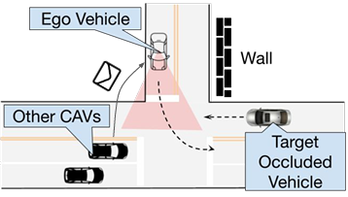
LiDAR and Cooperative Perception
SlowLiDAR (CVPR 2023): first systematic availability attack on LiDAR detection; differentiable proxies for non-differentiable preprocessing; slows six pipelines
CP-FREEZER (AAAI 2026): perturbed V2V messages maximize fusion delay: > 90× latency, > 3 s per frame, 100 % success on a real vehicle testbed
Trust boundary moves from the sensor to the V2X link (cf. L3.3 data fabrication)
SlowLiDAR (Liu et al., CVPR 2023); CP-FREEZER (Wang et al., AAAI 2026); Gu et al., Latency Attacks survey, arXiv:2609.36732, Sec. 4.3.
Notes:
CP-FREEZER is one of the few results on a physical closed system (a vehicle testbed). Cooperative perception also creates a new victim relationship: the attacker may be another vehicle, and the victim's perception delay is caused by messages the victim chose to trust. Figure illustrates collaborative perception (from the course material).

Slide 25
Perception Latency Attacks at a Glance
Method | Bottleneck | Delivery | Evaluated | Key result (native)
Overload | NMS | Digital | Target hardware | up to 10× inference time
Groundswell | NMS | Digital | GPU-timed | 101 → 19k candidates; 2.7×
SlowTrack | Tracker | Digital | Closed-loop sim | 28.4× pipeline; ~95 % crash
SlowPerception | NMS + tracker | Projector | Closed-loop sim | 2.5 s; 97 % collision
DetStorm | NMS | Physical objects | Target hardware | up to 8.1 s delay
TrackFlood | Tracker (NMS-free) | Digital | Target hardware | 1.09-1.47× at 8/255
SlowLiDAR | LiDAR runtime | Digital | Digital model | latency up on 6 pipelines
CP-FREEZER | Cooperative fusion | V2V message | Vehicle testbed | > 90×; > 3 s per frame
Native metrics and each paper's own baseline: rows are not comparable. Note how few reach closed-loop or testbed evaluation.
Gu et al., Latency Attacks survey, arXiv:2609.36732, Table 3.
Notes:
Review table, a condensed version of Table 3 in the survey. The evaluation column is the useful one: digital model evaluation, target hardware timing, closed-loop simulation, and vehicle testbed are different levels of evidence, and no entry is a full on-road deployment.

Slide 26
Outline
Why availability matters for AD
Latency attacks on perception
Latency attacks on VLMs and LLMs
Defenses: work budgets
From model-level cost to system failure
Open problems and discussion
Notes:
Part 3 (about 10 minutes): foundation models in the driving stack bring autoregressive decoding, and with it the output-length lever. See the LiU slides on VLM-based perception for the architecture.

Slide 27
Why VLM / LLM Components Change the Picture
Foundation models are entering driving: VLM-based perception, scene description, and planning (LiU talk)
Their cost is output-dependent: every generated token is one more decoder step, and reasoning models add thousands of reasoning tokens
Compared with a CNN detector, the attacker gains a new, wide lever: output length is controllable by the input
Compared with a chatbot, the victim has a hard deadline: there is no 'wait for the answer'
Same attack mechanism as in perception, different bottleneck: more tokens instead of more boxes
LiU talk, slides 23-25; Gu et al., Latency Attacks survey, arXiv:2609.36732, Sec. 6.
Notes:
Bridge from perception to generation. The survey notes that reasoning models expose a far wider controllable range of sequential inference work than earlier input-dependent stages (NMS, early exit, tracking state, translation).

Slide 28
The Output-Length Lever
Attack | Target | Mechanism | Reported (native metric)
NMTSloth (FSE 2022) | Neural MT | Delay EOS with one character or token change | Latency +85 % to +3,153 % (CPU)
NICGSlowDown (2022) | Image captioning | Imperceptible image perturbation lengthens captions | Latency up to +483.86 %
Engorgio (ICLR 2025) | Open LLMs | Optimized prompt suppresses EOS | 2-13× longer outputs, > 90 % of limit
LoopLLM (AAAI 2026) | LLMs | Repetition loops until the length cap | > 90 % of cap vs. ~20 % for EOS-delay
Verbose Images (ICLR 2024) | VLMs | Adversarial image induces long, repetitive text | 7.87× / 8.56× length; latency ~2× to 24×
For attacks that run to the limit, the factor is set by (output limit) / (benign length): a deployment parameter, not an attack property.
Gu et al., Latency Attacks survey, arXiv:2609.36732, Sec. 6.1-6.2 and 9.1.
Notes:
Key observation from the survey: when an attack reaches the configured output limit, the reported amplification is largely the ratio of that limit to the benign output length. NMTSloth found 1,370 of 1,455 public NMT models configured with a 500-600 token limit, far above typical outputs. So configuration is half of the vulnerability.

Slide 29
Reasoning Models: Infinite Thinking
Attack | Delivery | Reported (native metric) | Note
ReasoningBomb (CCS 2026) | Prompt | Avg. 18,759 completion tokens; 6-7× more than benign | The 286.7× input/output ratio is not an amplification factor
ThinkTrap (NDSS 2026) | Black-box API | 50-100× more tokens | Infinite-thinking loops
OverThink (2025) | Retrieved content | Up to 46× (context-agnostic), 7.8× (context-aware) | Answers stay correct
RA-ICA (2025) | Poisoned RAG corpus | Up to 13.1× tokens, > 90 % success | Answer integrity intact
Because several of these attacks keep the answer correct and bypass detectors, the survey argues for budget enforcement by construction, not detection.
Gu et al., Latency Attacks survey, arXiv:2609.36732, Sec. 6.2 and 8.1.
Notes:
Detection baselines in the ReasoningBomb paper show bypass rates of 99.8, 98.7 and 98.4 percent (input, output and joint detection). The survey is careful: this supports skepticism of those specific detectors, not a universal ranking of detection versus enforcement.

Slide 30
Reaching the Driving Stack
Natural-reflection backdoor on a driving VLM (Liu et al., 2025): a reflection pattern in the camera image makes the planner generate abnormally long responses: a measured rise in output tokens and latency
Delivery is a training-time backdoor; the trigger is something that occurs on real glass
Adjacent, not latency: FreezeVLA (76.2 % freeze rate) and Semantic-DoS (up to 98.3 % hard-stop) deny action without showing amplified computation
Distinguish: late (work amplification) vs. absent (denial of action) vs. wrong (integrity)
Liu et al., Natural Reflection Backdoor on VLM for AD (arXiv:2505.06413); Gu et al., Latency Attacks survey, arXiv:2609.36732, Sec. 6.2 and 7.4.
Notes:
The survey is strict: among embodied platforms only the driving-VLM reflection backdoor meets the bar for a latency attack (measured computational cost). FreezeVLA, Semantic-DoS, EDPA, MAVLA and ANNIE are availability-adjacent evidence. Use the three-way distinction late / absent / wrong as a discussion prompt.

Slide 31
Outline
Why availability matters for AD
Latency attacks on perception
Latency attacks on VLMs and LLMs
Defenses: work budgets
From model-level cost to system failure
Open problems and discussion
Notes:
Part 4 (about 13 minutes): defenses organized by what they actually bound.

Slide 32
Defense Families by Control Mechanism
Control mechanism | What it bounds | Examples | Limits
Budget enforcement | Work entering or leaving a stage; tokens | Pre-NMS top-k, token cap, runtime termination | Caps truncate hard legitimate inputs
Bounded / constant-time execution | Per-stage work or timing variation | Admission caps, constant-time NMS | Hardware effects still vary time
Input transformation | Perturbation reaching the model | Adaptive resize, JPEG, purification | Weak against adaptive attackers
Robust / adaptive training | Model behavior | Adversarial training for slowdown | Efficiency-robustness trade-off
Runtime monitoring | Anomalous internal counts | Track-count anomaly scores | Needs thresholds; adaptive evasion
System / serving control | Scheduling, queues, isolation | Admission control, rate limits | Not specific to perception
Gu et al., Latency Attacks survey, arXiv:2609.36732, Sec. 8 and Table 6.
Notes:
The survey organizes defenses by control mechanism, i.e., by what quantity each one bounds, not by which attack it was designed for. That makes it possible to ask the useful question of any defense: does it bound the quantity the attack inflates?

Slide 33
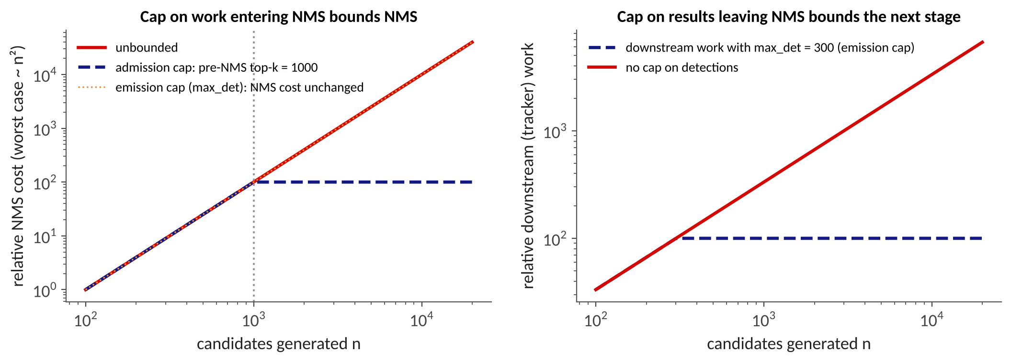
Admission Cap vs. Emission Cap
Admission cap (before the expensive stage): pre-NMS top-k, tracks admitted to association, token budget in the decoding loop: bounds that stage's own work
Emission cap (after it): e.g., `max_det` in Ultralytics: bounds the next stage's input, but NMS already did its full work
Autoregressive decoding is where the two coincide: a max-token limit caps both (for the decode phase)
Original figure (conceptual). Definitions from Gu et al., Latency Attacks survey, arXiv:2609.36732, Sec. 8.4.
Notes:
Conceptual figure, original: relative worst-case cost versus number of candidates n. Left: with a pre-NMS cap at 1,000 the cost plateaus; an emission cap leaves NMS cost unchanged. Right: with max_det = 300 the downstream (tracker) work is bounded. Greedy NMS could in principle terminate early after K kept boxes (O(Kn) instead of O(n^2)), but implementations such as the torchvision kernel used by Ultralytics compute the full keep set first.

Slide 34
Case: max_det Looks Like a Fix, But...
152-300 → 6-8
5
post-NMS boxes under attack,
max_det 300 → 10
benign count under
the same cap
What it shows
A single emission cap bounds the detection count handed to the tracker and planner
Independent of the attack's loss or perturbation model
What it does not show
That NMS work or latency fell (the metric is censored at the cap)
Safety in crowded scenes: 10 detections is too few
A bound on the persistent tracker pool
Monteuuis et al., NeurIPS 2025; Gu et al., Latency Attacks survey, arXiv:2609.36732, Sec. 4.1 and 8.4.
Notes:
EVADE reduced max_det from 300 to 10 and the post-NMS box count under four NMS attacks fell from 152-300 to 6-8, versus a benign count of 5. But this metric is right-censored at the cap by construction; it does not show NMS ran faster, and at the default of 300 the attacks were not neutralized. What it does show: downstream consumers get a bounded detection count per frame. The value 10 was chosen to match the maximum object count in COCO images and would discard genuine detections in crowded traffic. Lesson: always ask which quantity a defense bounds.

Slide 35
TrackShield: Admission Caps in the Tracker
140 → 6.3 ms
100 % → 0.7 %
~1 ms
tracking-stage latency
under SlowTrack
deadline-miss rate
at a 50 ms threshold
per-frame overhead
• Inside the ByteTrack update: hard admission guard before the cost matrix is built; caps at the 99th percentile of benign counts
• Plus an EWMA / MAD anomaly monitor that limits track births and prunes likely phantom tracks
• Jetson AGX Orin, YOLOX-S + ByteTrack (our group's measurement)
• Limits: upstream re-identification is unprotected; accuracy is not restored; tested against transferred, not adaptive, attacks
TrackShield (Gu, Singh-Smith, Liao, Liu; HPCC 2026, to appear); Gu et al., Latency Attacks survey, arXiv:2609.36732, Sec. 8.4.
Notes:
Our group's defense. Honest limits come from the authors: the guard bounds only the admitted association dimensions, not detector, NMS, re-identification or persistent-state cost; in a BoT-SORT-ReID transfer, re-identification of raw detections upstream of the guard still took about 10.85 s of 10.94 s. The defense contains workload but does not restore MOTA; at the most aggressive monitor setting MOTA falls from 57.19 to 14.70 (0.97 point loss at the conservative setting). Evaluated against transferred, not adaptively re-optimized, attacks.

Slide 36
Input Transformation: Cheap, but Check the Adversary
Adaptive input resizing: -90.18 % NMS time on an attacked YOLOv5-large (Beyond PhantomSponges)
EVADE: an off-the-shelf diffusion purifier (PDM-Pure) returned the post-NMS box count to the benign 5; plain JPEG was nearly as effective (but less consistent across models)
Both were tested only against non-adaptive attackers; the metric is an output count, not NMS time
Where an adaptive attacker was tested (BPDA / EOT against an edge-cloud gate), all twelve training-free preprocessing baselines failed: attacked offload ≥ 99.8 %
Takeaway: input transformation raises the bar for existing attacks, not for adaptive ones
Schoof et al. 2024; Monteuuis et al. 2025; GateDrain (Gu et al., arXiv:2609.33992); Gu et al., Latency Attacks survey, arXiv:2609.36732, Sec. 8.3.
Notes:
Teach the standard lesson from L3.2 again in the availability setting: a defense evaluated against non-adaptive attackers proves little. The GateDrain result (Gu et al.) is the negative adaptive result referenced here.

Slide 37
Budgets for Reasoning: Hard vs. Soft
Control (reasoning length) | Strength | Guarantee
Runtime termination, token accounting | Hard | Enforces a configured upper bound
Parameter-level (CoT-Valve, learned length direction) | Medium | Reduces observed length; no certified maximum
Prompt-level (TALE, Concise CoT) | Soft | Encourages brevity; can be removed or ignored
A cap has no bypass rate and needs no attack examples; its cost is paid by benign inputs that legitimately exceed it, and the operator chooses that cost. Use difficulty-adaptive budgets for genuinely hard problems.
Gu et al., Latency Attacks survey, arXiv:2609.36732, Sec. 8.1 and Table 5.
Notes:
From Table 5 of the survey. 'A prompt instruction is not a cap.' Detectors have an error rate that the attacker optimizes against; a cap's cost is set by the operator's threshold, not by the attacker's effort, but only for the quantity the cap actually bounds (previous two slides).

Slide 38
Timing Is Also a Side Channel
Data-dependent runtime leaks information: NMS time reveals internal inference state and can sharpen black-box, decision-based attacks (Biton et al., AISec 2023)
Opposite goal from latency attacks (confidentiality, not availability), same observable: variable runtime
Motivates constant-time NMS: removes both the latency lever and the timing leak within the implementation boundary
But: even with fixed nominal operations, wall-clock time varies through memory access, caching, contention, and thermal state
Biton et al., The Adversarial Implications of Variable-Time Inference, AISec 2023; Gu et al., Latency Attacks survey, arXiv:2609.36732, Sec. 4.1, 7.3, 8.4.
Notes:
The survey flags timing leakage as adjacent, not folded into the amplification mechanism. A caveat to give students: constant-time implementation is a requirement on an implementation boundary, not a property of a whole system.

Slide 39
Outline
Why availability matters for AD
Latency attacks on perception
Latency attacks on VLMs and LLMs
Defenses: work budgets
From model-level cost to system failure
Open problems and discussion
Notes:
Part 5 (about 12 minutes): the central analytical point of the survey: whether a latency attack is dangerous is decided by the system, not by the model.

Slide 40
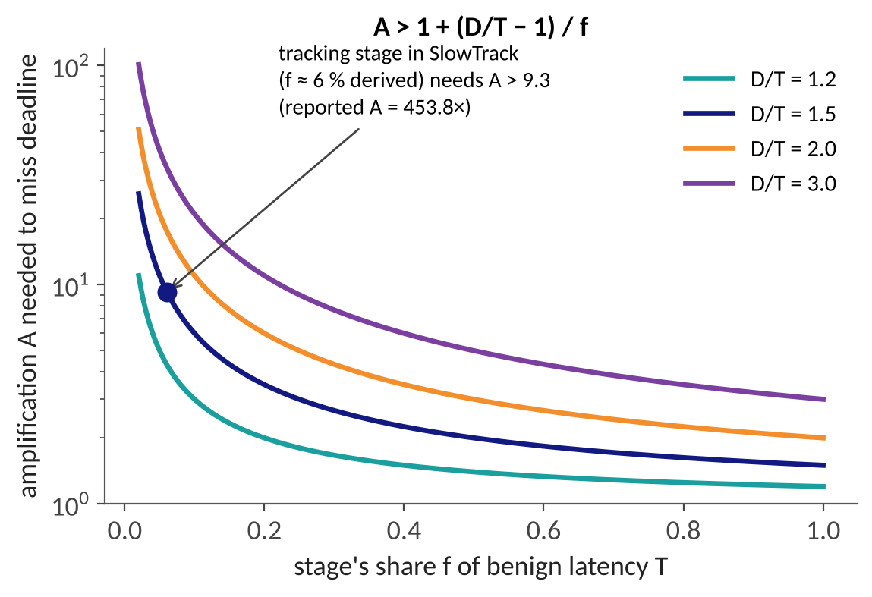
When Does Amplification Miss a Deadline?
Pipeline with benign latency T; one stage has benign share f and is amplified by A
Sequential stages: A_e2e = 1 + f (A − 1)
Deadline D is missed only if A > 1 + (D/T − 1) / f
Neither f nor D/T is a property of the model: they belong to the system
Original plot of Eq. (3)-(4), Gu et al., Latency Attacks survey, arXiv:2609.36732, Sec. 9.1. f for SlowTrack derived from reported averages.
Notes:
First-order model from the survey, Eq. 3 and 4. The plot is ours: required amplification versus f for several slack ratios D/T. The SlowTrack point uses f of about 6 percent, which we derive from the reported averages (453.8x stage, 28.4x pipeline): f = 27.4/452.8 = 6.05 percent. This is derived from averages, not a measured share; with D/T = 1.5 the required A is about 9.3, far below the reported 453.8x.

Slide 41
Worked Example: Big Stage Factor, Smaller Pipeline
453.8× → 28.4×
≈188× → 2.7×
1.0-1.3×
SlowTrack: tracking stage
vs. whole pipeline
Groundswell: NMS candidates
vs. end-to-end latency
tracker slowdown behind
NMS-free detectors (ByteTrack)
• The unamplified stages dilute the effect: stage-level factors overstate pipeline-level risk
• The attacker can also choose the path: AESOP: 2,407× FLOPs targeting the execution path vs. 117× for the single most vulnerable model
• Conversely, a modest factor can be fatal near a queueing knee (GateDrain: 2.16× demand, 2.26-12.8× benign p99)
Gu et al., Latency Attacks survey, arXiv:2609.36732, Sec. 9.1 (C1, C5); SlowTrack, Groundswell, AESOP, GateDrain as reported.
Notes:
Two examples from the survey. SlowTrack: tracking stage 453.8x, whole pipeline 28.4x, consistent with the tracker being only a few percent of benign latency. Groundswell: 188x more candidates, 2.7x end-to-end. Behind NMS-free detectors the fixed-cost detector dominates, so tracker slowdowns become 1.0-1.3x for ByteTrack. And the attacker can pick the path: AESOP reports 2,407x FLOPs by targeting the execution path vs 117x for the most vulnerable single model.

Slide 42
Six Conditions Between Model and System
Condition | What decides it | Evidence
C1 Critical-path share | Benign share f of the amplified stage; concurrency | 453.8× stage vs. 28.4× pipeline
C2 Headroom vs. slack | Ceiling on the amplified count; D/T | TrackFlood: no miss at 8/255, all missed at 32/255
C3 Clipping | Existing caps and timeouts | AESOP: throughput collapse or 96.7 % data discarded
C4 Accumulation | State and queues across frames | Tracker pool 20.5 → 1,677.7
C5 Sharing | Co-tenancy, shared queues | 2.16× demand → 2.26-12.8× benign p99
C6 Consequence mapping | Fallback policy; closed-loop dynamics | ~95 % crash vs. a safe stop in a different design
Gu et al., Latency Attacks survey, arXiv:2609.36732, Table 7.
Notes:
Table 7 of the survey. None of the six is a property of the attacked model alone. C6 in particular: a system whose fallback triggers a safe stop would convert a similar delay into loss of availability rather than a collision, so the same attack can be a crash in one design and an inconvenience in another.

Slide 43
Exercise: Is This Attack Dangerous?
Given
Pipeline T = 30 ms, deadline D = 45 ms
Tracker share f = 5 %
Attack amplifies the tracker by A = 50
Compute
Threshold: 1 + (D/T − 1) / f = ?
A_e2e and the new latency = ?
Deadline missed?
Then change one thing
An admission cap limits A to 5
What is the new A_e2e?
Discuss
The fallback is a safe stop instead of continuing: is the outcome a collision or lost availability?
Which of C1-C6 did you just vary?
Exercise built on Eq. (3)-(4) of Gu et al., Latency Attacks survey, arXiv:2609.36732. Numbers are invented for teaching, not from a paper.
Notes:
Class exercise (5 minutes). Give each group the same attack and different system parameters. Example: tracker stage A = 50, f = 5 percent, T = 30 ms. With D/T = 1.5 the threshold is 1 + 0.5/0.05 = 11, so 50 exceeds it and the deadline is missed: A_e2e = 1 + 0.05 x 49 = 3.45, so 103 ms against a 45 ms deadline. With a fixed admission cap that limits A to 5, A_e2e = 1.2 and there is no miss. Then ask: what changes if the fallback is a safe stop? Answer: collision becomes unavailability.

Slide 44
Real-Time Systems View: AI Has No WCET
Classical real-time design guarantees timing through worst-case execution time (WCET) analysis and schedulability tests
AI-based perception has no WCET: execution time depends on the input, and attacks search for high-cost inputs, not proven maxima
Admission caps turn input-dependent work into a bounded quantity; a runtime guard bounds elapsed time but converts overrun into missing or partial results
Design options: bound work, bound time, add a fallback (safe stop, degraded mode), isolate resources across tasks
LiU talk, slide 29; Gu et al., Latency Attacks survey, arXiv:2609.36732, Sec. 2.5 and 8.4.
Notes:
From the LiU talk's closing slide and the survey's discussion of bounded execution. WCET is the classical term for a proven maximum; the survey deliberately avoids using 'worst case' for empirically found slow inputs. Connect to your real-time systems background: schedulability analysis for AI pipelines is an open research direction.

Slide 45
A Better Evaluation Checklist
Report with every amplification factor | Why
Benign latency T, deadline D, stage share f | Lets a reader compute whether Eq. (4) is satisfied
Ceiling on the amplified count; existing caps and timeouts | Bounds what the attack can reach (C2, C3)
Hardware, resolution, confidence threshold, pre-NMS cap, NMS implementation | Amplification is a property of attack, model, and configuration
Absolute deadline-miss increase, slack, consecutive misses, recovery time | Real-time outcome, not a ratio
Fallback policy and terminal outcome | Crash vs. safe stop (C6)
Attacker cost: one-time and per-delivery | Cost-impact pair; delivery realism
Gu et al., Latency Attacks survey, arXiv:2609.36732, Sec. 2.5, 9.1, 9.2.
Notes:
Condensed from the survey's recommendations (Sec. 2.5 and 9.2). Use as a rubric when reading any latency-attack paper in the reading assignment.

Slide 46
Outline
Why availability matters for AD
Latency attacks on perception
Latency attacks on VLMs and LLMs
Defenses: work budgets
From model-level cost to system failure
Open problems and discussion
Notes:
Part 6 (about 8 minutes): open problems and discussion.

Slide 47
Open Problems
Physical realizability end to end: most physical results are partial (projector + simulator, or hardware timing); no full on-road deployment
NMS-free and other new detectors: TrackFlood shows the bottleneck relocates; within-detector surfaces (feature necks, deformable attention, token pruning) are unvalidated conjectures
Bound the worst case of VLM / VLA perception; schedulability analysis for AI-based pipelines; anytime models with deadline-aware early exit (LiU talk)
Adaptive attacker evaluation for every defense; standardized, system-level benchmarks with downstream outcomes
LiU talk, slides 29-30; Gu et al., Latency Attacks survey, arXiv:2609.36732, Sec. 10.
Notes:
Open directions drawn from the LiU summary slide and Section 10 of the survey. Emphasize that the within-detector surfaces are explicitly flagged by the survey as research conjectures, not demonstrated attacks.

Slide 48
Discussion Questions
Why can an attack that preserves every detection still be a safety attack? Give a timeline.
A vendor claims '100× slowdown found in our detector'. Which five numbers do you ask for?
Where would you put a cap in an Apollo-like stack: before NMS, before association, or at the controller input? What does each protect, and what does it cost?
Safe stop vs. keep driving on stale data: which fallback turns a latency attack into an availability failure rather than a collision?
How would an adaptive attacker respond to the cap you chose?
Discussion prompts for class.
Notes:
Use as seminar prompts or a short written assignment. Suggested answers: (1) the planner acts on late or missing tracks; (2) T, D, f, hardware/config, ceiling; (3) admission caps bound the stage, but a cap at the controller input does not protect upstream stages; (4) safe stop; (5) stay below the cap but exploit persistent state.

Slide 49
Reading List
Survey: Gu, Gao, Saremi, Chakraborty, Deep Learning Latency Attacks and Defenses (arXiv:2609.36732); companion site: github.com/guzonghua/awesome-latency-attacks
Shumailov et al., Sponge Examples (EuroS&P 2021)
Ma et al., SlowTrack (AAAI 2024) and SlowPerception (arXiv 2024)
Monteuuis et al., Latency NMS Attacks: Real Life or Fantasy? (NeurIPS 2025)
Wang et al., CP-FREEZER (AAAI 2026); Muller et al., DetStorm (IEEE S&P 2025)
Gu et al., TrackFlood and TrackShield (2026): our group's work on trackers
See the next slide for the full reference list.
Notes:
Suggested required reading: Sponge Examples and EVADE; recommended: SlowTrack, CP-FREEZER, and the survey's Sec. 9.1.

Slide 50
References
Gu, Gao, Saremi, Chakraborty. Deep Learning Latency Attacks and Defenses. arXiv:2609.36732, 2026.
Shumailov et al. Sponge Examples: Energy-Latency Attacks on Neural Networks. EuroS&P 2021.
Shapira et al. Phantom Sponges. WACV 2023; Chen et al. Overload. CVPR 2024; Schoof et al. Beyond PhantomSponges. WiseML 2024.
Xia, Gao, Shi. Stealthy Latency Attacks Against Camera-Based Object Detection. VehicleSec 2026.
Ma et al. SlowTrack. AAAI 2024; SlowPerception. arXiv:2406.05800; Muller et al. DetStorm. IEEE S&P 2025.
Monteuuis, Chen, Petit. Latency NMS Attacks: Is It Real Life or Is It Just Fantasy? NeurIPS 2025.
Liu et al. SlowLiDAR. CVPR 2023; Wang et al. CP-FREEZER. AAAI 2026; Jia et al. Fooling Detection Alone Is Not Enough. ICLR 2020.
Gu et al. TrackFlood arXiv:2609.33948; TrackShield, HPCC 2026; GateDrain arXiv:2609.33992.
Gao et al. Verbose Images. ICLR 2024; Dong et al. Engorgio. ICLR 2025; Liu et al. ReasoningBomb. CCS 2026; Kumar et al. OverThink. arXiv:2502.02542.
Liu et al. Natural Reflection Backdoor on VLM for AD. arXiv:2505.06413; Biton et al. Adversarial Implications of Variable-Time Inference. AISec 2023.
Notes:
Full references. arXiv identifiers as given in the survey's reference list.

